Slide 1
Pipeline Project An analysis of the program funnel
Graham Harris
NYU Entrepreneurial Institute
Notes:
Hi

Slide 2
Interim Presentation Goal
Feedback!
Notes:
The main goal of this interim presentation is feedback!
I have all the data and I’m discovering some insights that are really cool – this is a time for me to present that and for you to ask me any questions that’ll guide me to the final draft of the project. Please ask any and all questions you can think of!

Slide 3
Overview
Test the hypothesis of the “funnel” of events
Sub-objectives: data cleaning and diversity
Spent first month cleaning 3 years worth of coaching, SS, FF, HTSAS, Bootcamps, Sprints, Launchpads
Clustered this data into network visuals
Present a package of findings/insights for improved marketing, programs dev., etc
Cleaned data located in Google folder
Notes:
Are people actually travelling through the funnel in the way that we think they are?
Final draft will be a data resource for everyone to use going forward

Slide 4
Funnel
HTSAS, SS, FF (coaching)
Bootcamp
Sprints (Summer and J-Term)
Launchpad
Top:
Bottom:
Sub-funnel
Notes:
Funnel and sub-funnel structure

Slide 5
Assumptions/Notes
Data cleaning:
I stopped counting founders after the 4th person for programs
I only used bootcamp application data, not attendees – the apps were more consistent. I do have some attendee data.
Affinity data (all people and organizations) is from July 14th, 2021
Normal computing errors (extra spaces, misspelled names, etc.)

Slide 6
Methodology
People vs. Teams:
People: funnel as a whole
Teams: efficacy of the sub-funnel
For both people and teams:
2018-2019, 2019-2020, 2020-2021
All the above
All the above, simplified (without dates)
10 total graphs

Slide 7
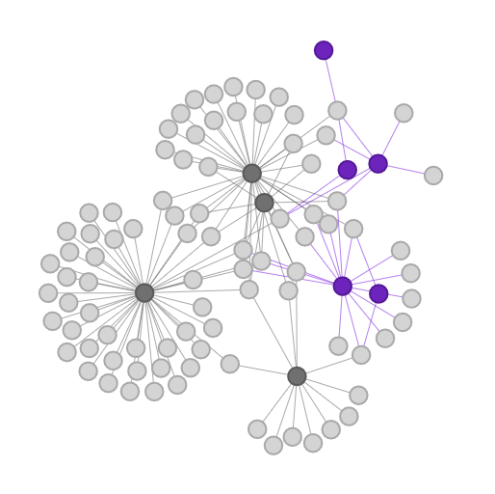
How to read the graphs
Person/Team
Sub-funnel Event
Event
(% who attended ONLY this event)
Notes:
Network graph - funnel and sub-funnel structure
Explain what a node and edge are
NOTE: Summer program attendees will NOT have the percentage because the data is skewed. Everyone who got into a summer program (SLP and Summer Sprint) had to have applied. The way I calculated the percentages was by seeing who attended only one program, whereas those would technically count as two.

Slide 8
Graphs
Notes:
So without further ado….
start w teams

Slide 9
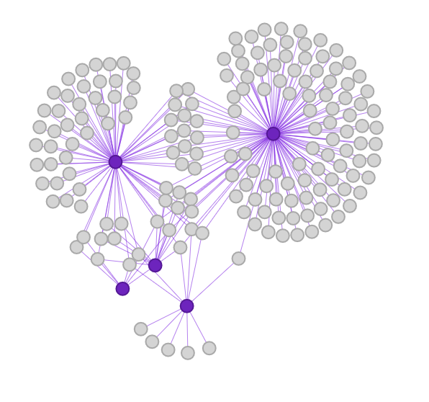
Teams 2019
BC
(78%)
S Apps
(52.7%)
Summer Sprint
SLP
J Sprint
(45%)
Notes:
NOTES FOR ALL 3 YEARS:
Everything looks like it makes sense – There’s a sizeable amount of applicants to the BCs and to Summer programs who don’t move
Bootcamp data doesn’t contain people who actually got accepted – can’t tell if the follow through rate there is acceptable or not
Very similar throughout the years
FRANK – applicants vs acceptees, as they move through the funnel. For each event?
Cross referencing, labeling

Slide 10
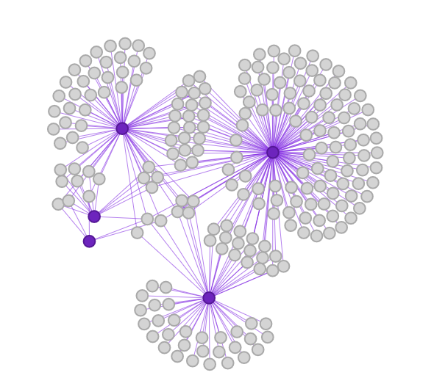
Teams 2020
BC
S Apps
(67.1%)
(42.5%)
Summer Sprint
SLP
J Sprint
(55.5%)

Slide 11
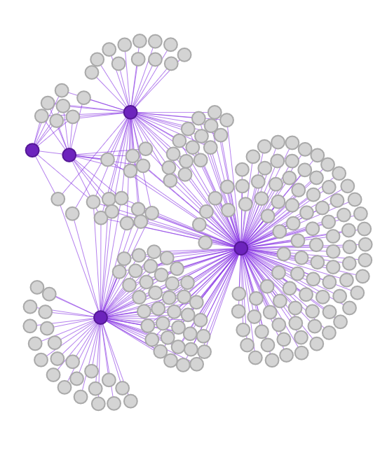
Teams 2021
S Apps
(23.5%)
BC
(58.6%)
SLP
Summer Sprint
J Sprint
(31.4%)

Slide 12
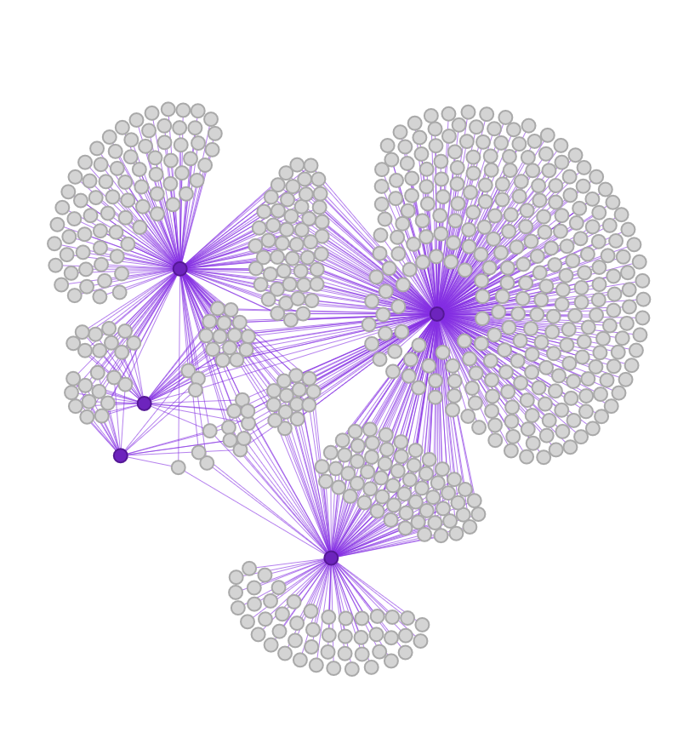
Simplified Teams
S Apps
(40.1%)
BC
(64.8%)
Summer Sprint
SLP
J Sprint
(35.3%)
Notes:
Not a lot of teams matriculate through the entire pipeline, but there are a bunch who do just 2 programs
Unfortunately can’t tell of these teams attended a bootcamp or not

Slide 13
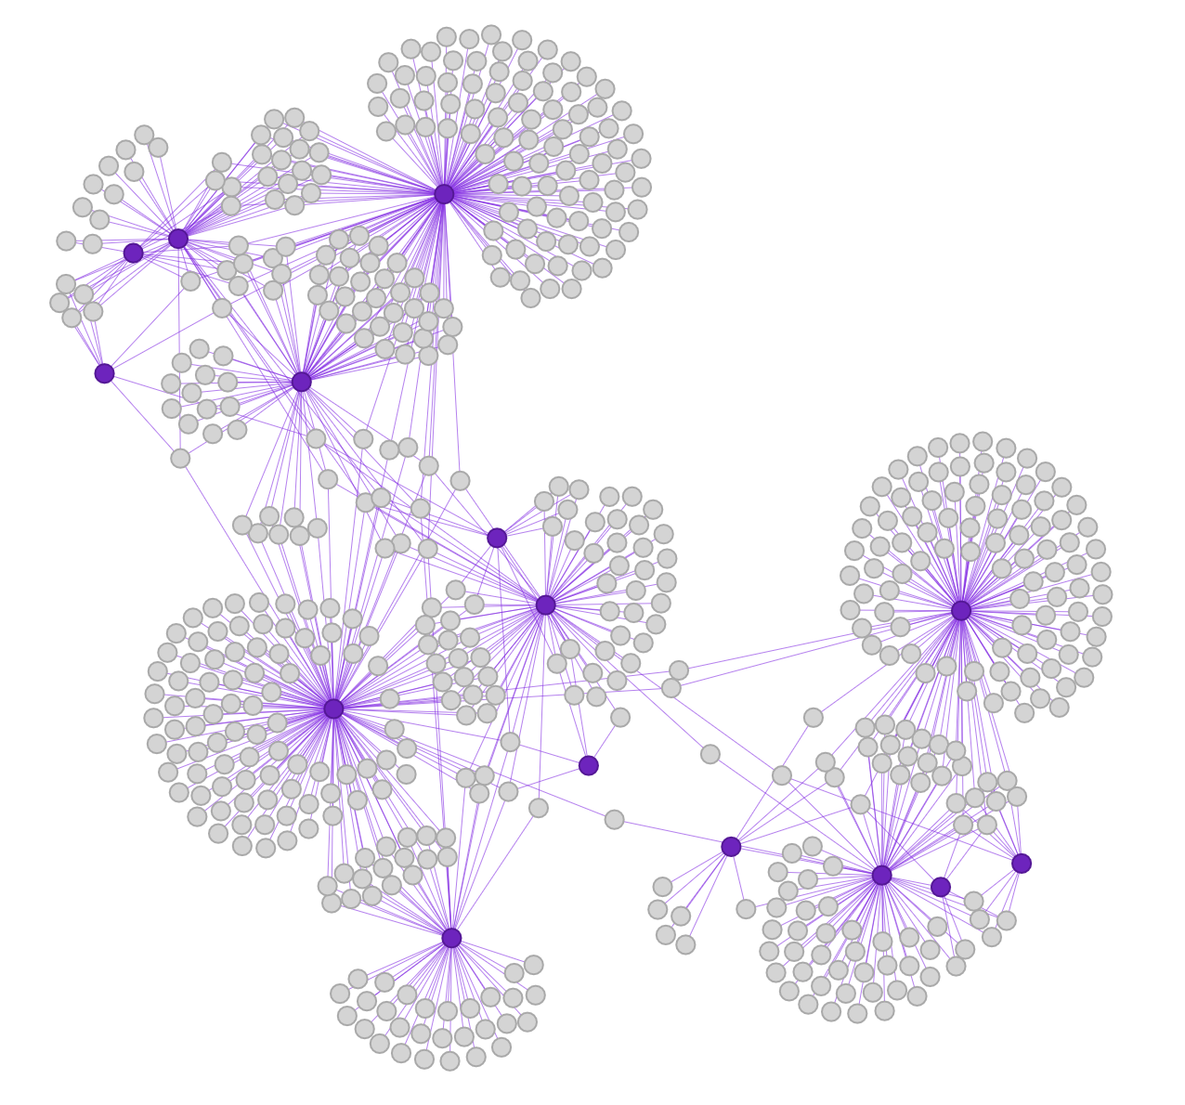
All Teams
2020
2019
2021
Notes:
Shows relationship between the years
Interestingly, 2019 seems kind of isolated, but 2020 and 2021 are better connected. Caused by the pandemic because nobody had things going on that summer? If you’re sitting at home, may as well work on your startup.
Unfortunately there are only 3 years worth of data (2 summers) so can’t tell if this is a trend or an assumption
Do better teams go through time, do better teams stay w us longer?
Givee Rebecca the names of crossover teams

Slide 14
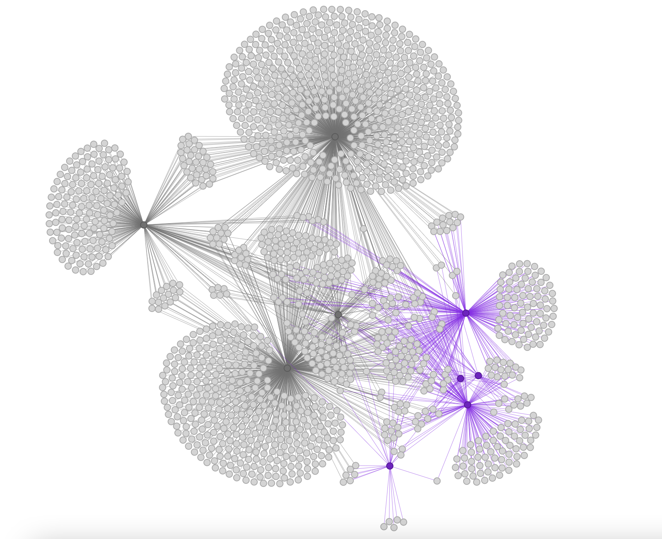
People 2019
SS
(74.1%)
HTSAS
(0%)
BC
(34.7%)
SLP
FF
(55.1%)
Summer Sprint
Coaching
(52.9%)
S Apps
(17.9%)
(38.6%)
J Sprint
Notes:
Lots of Coaching and SS participants who either did no other programs or just those two programs – the groups are relatively exclusive from other events. Coaching gets better as the years go on, SS not as much
FF is just a smaller version of the above?
The real star is HTSAS – it looks like almost everyone in that group participated in more events (depends on if you consider coaching and HTSAS the same thing, but even then there’s a very large group of them who participate in other events)
Bootcamp and Summer applicants both have similar numbers of people who applied without doing any other programs – should this be different due to the intensity of the programs? Do we just assume that a flat number of people apply to these programs without doing anything else?
This one definitely proves the sub funnel – it looks like almost all the people who got into a Sprint and/or Launchpad had done previous events. Very rare exceptions that consist of a minority of the population

Slide 15
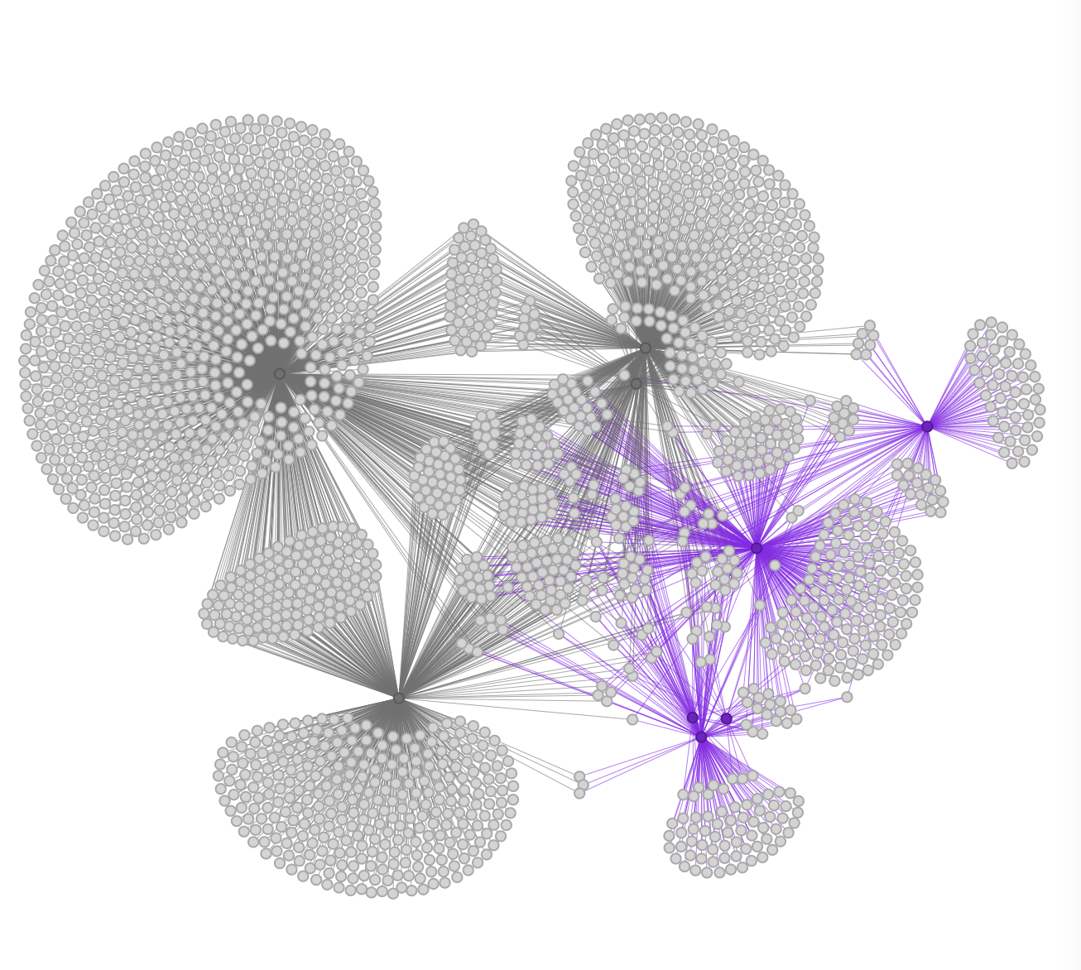
People 2020
Coaching
(43.5%)
J Sprint
HTSAS
(44.7%)
(1.2%)
BC
(35.1%)
SS
(67.3%)
SLP
FF
(49%)
S Apps
Summer Sprint
(35.3%)
Notes:
FF and SS have very large groups that interact with either no other program or only each other – there is some matriculation into other programs. Is this an acceptable rate?
JSprint this year has a lot of teams that didn’t do any other events
Summer applicants were 50/50 either very involved or not at all

Slide 16
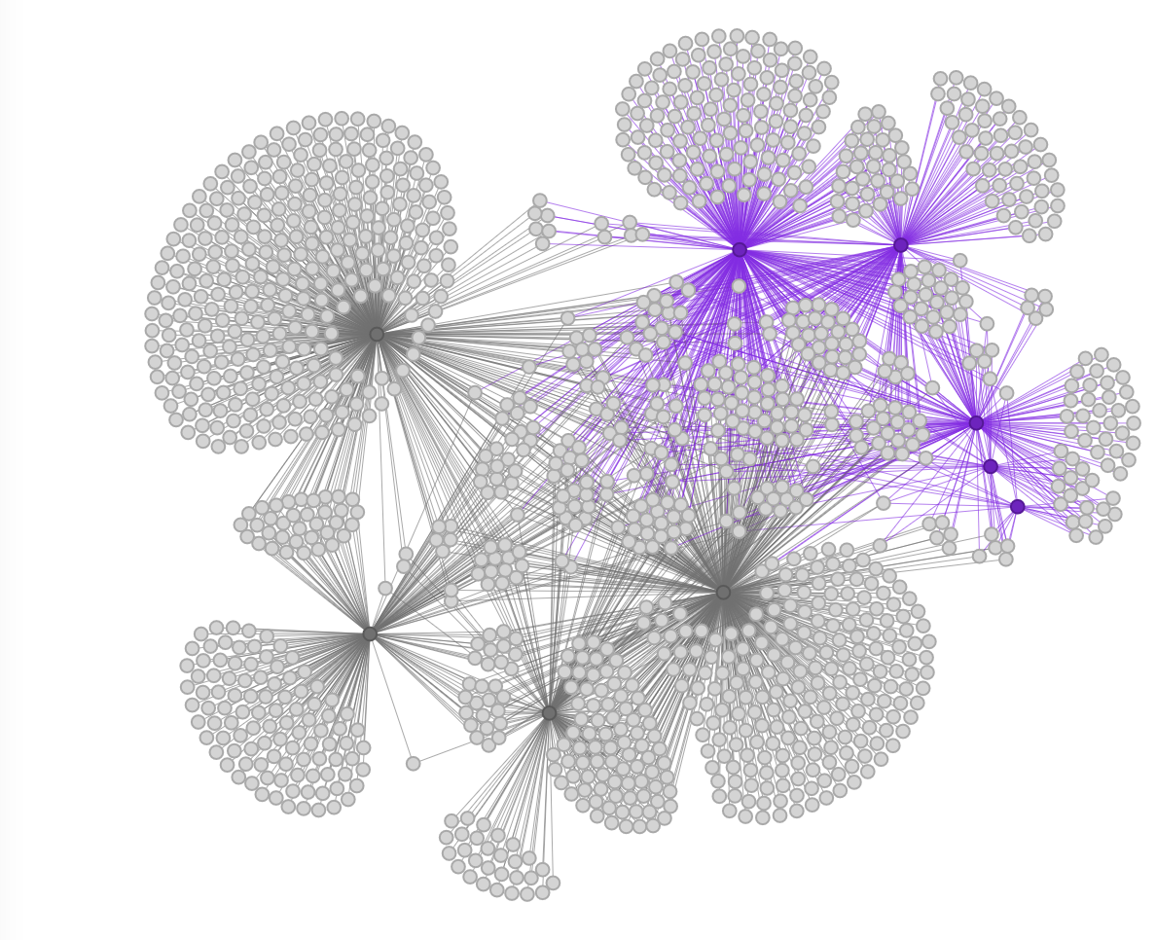
People 2021
J Sprint
BC
(28.5%)
(33.2%)
S Apps
(19.5%)
SS
(66.9%)
SLP
FF
(44.7%)
Summer Sprint
Coaching
(13.6%)
(37.3%)
HTSAS
Notes:
Coaching and FF are more interconnected in this one, which kind of tells me that we’re doing a good job encouraging people, however that might be right now
Over half bootcamp apps involved in other programs
Over half jsprint did not

Slide 17
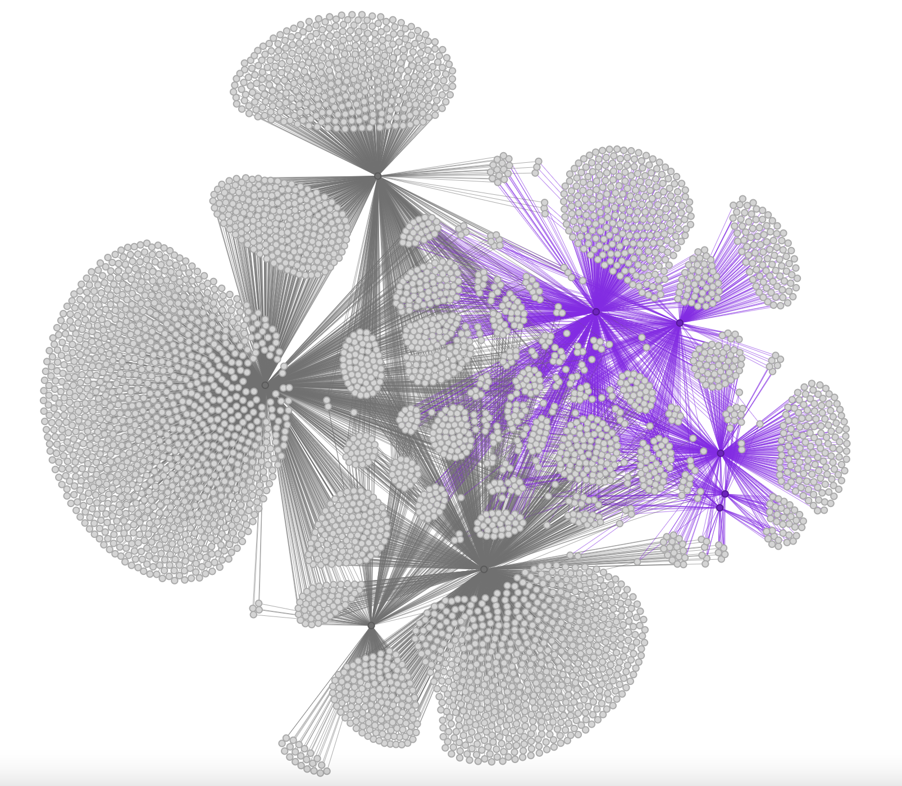
Simplified
People
BC
(27.1%)
FF
J Sprint
(38.4%)
(27.6%)
SS
(55%)
S Apps
(28%)
Summer Sprint
SLP
(5.2%)
HTSAS
Coaching
(37.2%)
Notes:
Good perspective into relative size of the subfunnel compared to the total funnel
HTSAS is the standout top of funnel program – great integration into other programs
Startup school and coaching don’t have a ton of integration
Large quantity of female founders participants also do SS, relatively low matriculation into other events. Maybe because of level of intensity?

Slide 18
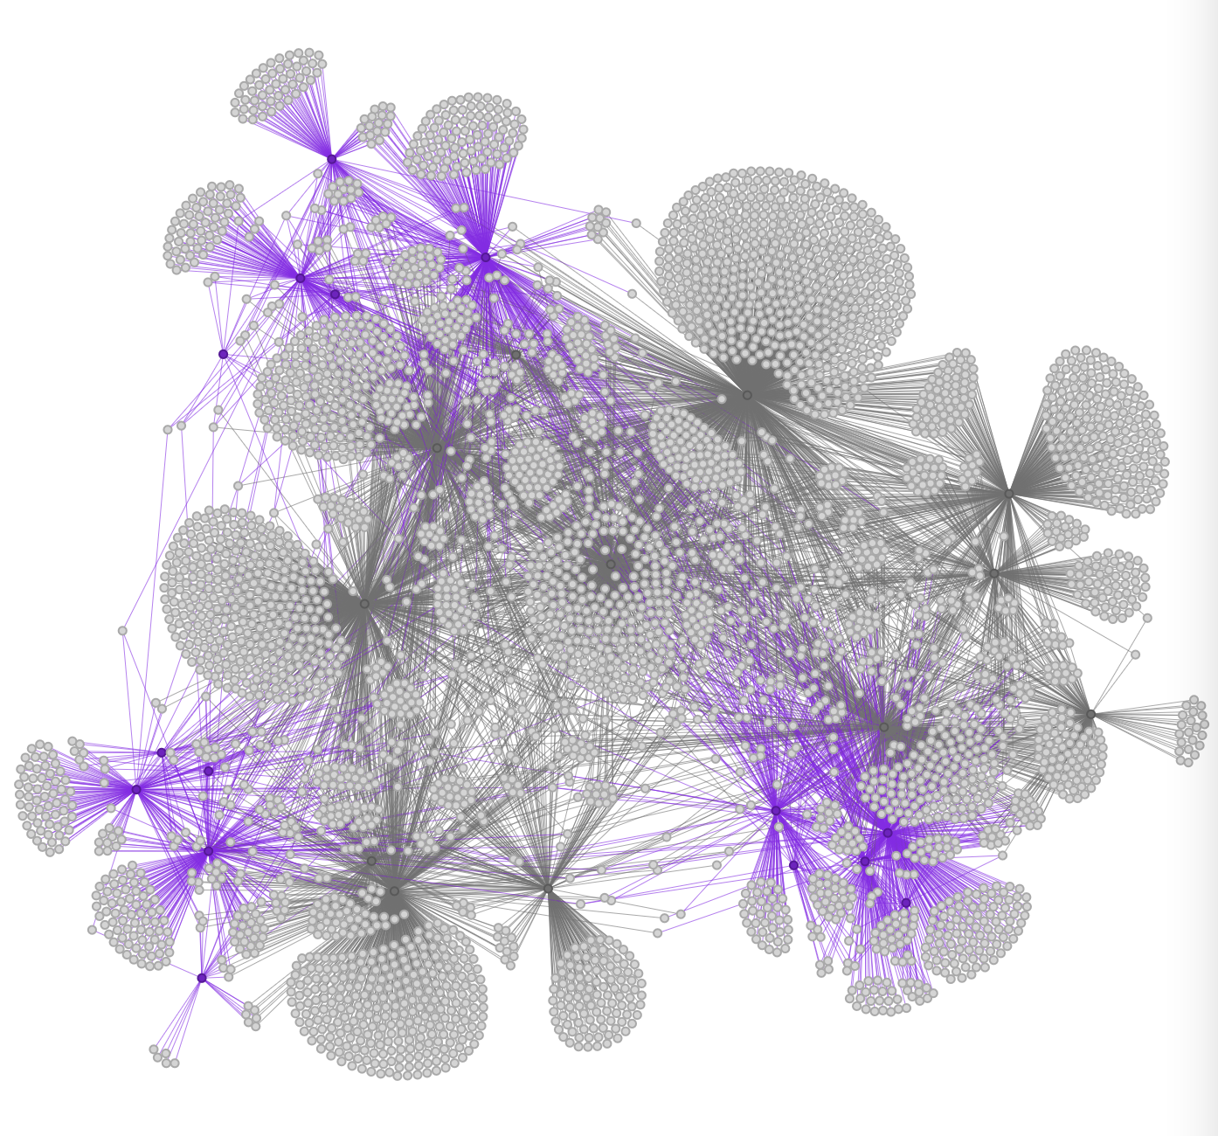
All People
2020
2019
2021
Notes:
Shows relationship between the years
Pure chaos
Events have kind of triangulated into the year
Gives you a good perspective of relative size though! Ex: Startup schools from year to year

Slide 19
Analysis
Notes:
Some analysis

Slide 20
Most Interesting Findings
HTSAS is really achieving the most immersion into other programs!
Coaching doesn’t interact as much as we thought – even though we coach sub-funnel teams, most coaching isn’t interacting
SS and FF engaged more and more each year – whatever we’re doing is working (keep pushing programs!)
Sub-funnel behaves the way hypothesized – by level of intensity

Slide 21
Additional Areas of Exploration
Diversity – different method of analysis, can be difficult to classify
Multiple pronouns / pronoun ambivalence (using multiple sets)
Compound ethnicities (bi-racial, multi-racial, international origin, etc)
Div. data isn’t available for all programs/years (no consistent picture) – could work on a rough picture of gender
Surveys – behavior analysis
Suggestions?
Notes:
Compound ethnicity example – white Hispanic vs. Latinx vs. Black Hispanic. I’m sure everyone knows the relative ins and outs of diversity, but in terms of calculation, it just is very hard to pinpoint the perfect way to do this

Slide 22
Data Cleanup Recs
Dropdown menus are your best friend! Include an “other” category and an extra field for more detailed info.
Take this data in a consistent format:
Pronouns (include as many options as realistic)
Stick with ONE format (she/her vs. she/her/hers
Ethnicity (checkboxes with “other”)
Academics (single choice)
Avoid self-description where possible
Steal from a ”pick list” - use the same language on applications
Notes:
Cute anecdote for avoiding self description – someone listed themselves as “left-handed” on one of the applications for the summer programs, it’s things like that to avoid. Not only can I not analyze written text, people are just inclined to include wrong or irrelevant information.
SCHOOLS – stern, tandon, cas, etc
APPLICATIONS AND PARTICIPANTS, then gender
Data cubes

Slide 23
Appendix
Notes:
If necessary

Slide 24
Program Abbreviations
FF = Female Founders
SS = Startup School
HTSAS = How to Start a Startup
BC = Bootcamp Applications
S Apps = Summer Applicants
SLP = Summer Launchpad

Slide 25
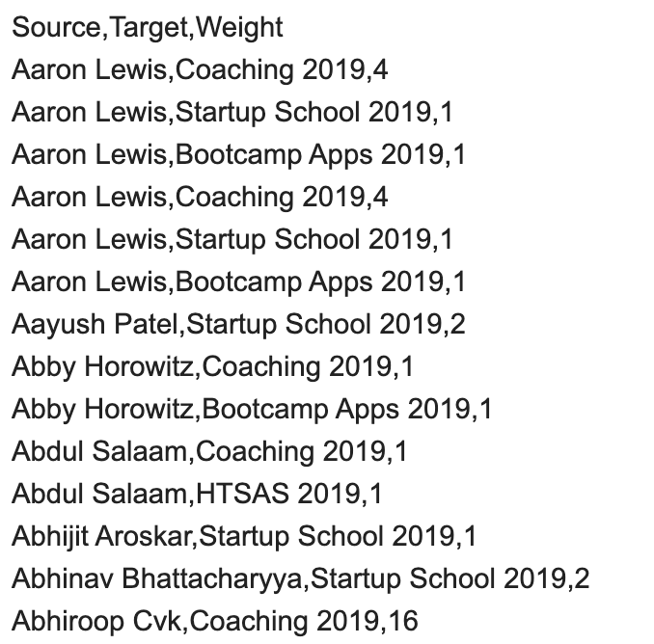
Adjacency
Header
Relationships
Notes:
So the way I analyzed the data is through adjacency lists like this one, here’s what the structure looks

